Slide 1
Corpus-based pedagogy and EFL: Trends and prospects
Sandra Gollin-Kies, PhD
Professor of languages and literature, Benedictine University, Lisle IL. USA.
ICELT Conference
University of Social Sciences and Humanities, Ho Chi Minh City, Vietnam
Sept 30, 2022.

Slide 2
Teaching scenarios
Unexpected questions in class
Does common mean the same as popular?
Does even though mean the same as even if?
Providing feedback on students' speaking or writing
Do the words information or research ever take a plural "s" ending?
Do academic writers use phrasal verbs like look into or do they prefer a Latin-based verb like investigate?
Are phrases like a lot of or a bunch of more common in speech or formal writing?
Preparing lessons
Which vocabulary or grammatical structures are useful to teach?
Where can I get authentic examples of word and phrase usage?

Slide 3
Learners’ concerns
How are particular words, phrases, or grammatical structures used by competent users of English?
What are some appropriate synonyms or collocates for a word?
I've used a lot of common words like make, get and say in my writing; what synonyms are appropriate for my purpose?
What synonym is appropriate for children in a context ? Kids, offspring, progeny?
How can I let go of my “lexical teddy bears” - besides, on the contrary and all in all?
How does my writing compare with other students' or professionals' writing?
Percentage of words from the General Service List, Academic Word List or Academic Vocabulary List
Lexical density (proportion of content to function words)
Use of personal pronouns, verbs, prepositions, conjunctions, discourse markers etc.

Slide 4
Overview
Part one
Introduce corpus-based pedagogy (DDL).
Summarize claims made by researchers about the use of DDL in EFL.
Take a look at some current trends based on research findings (meta-analyses etc.)
Part two
Suggest how can teachers and learners can get started with DDL with a look at some searches.
Conclude with some caveats and prospects.

Slide 5
What is DDL?
We live in a world of "big data." Used to searching Google, social media, online resources like dictionaries, etc.
The term Data-Driven Learning was coined by Tim Johns (1991).
DDL means that language learners work with written or spoken data, with the goal of “increased language sensitivity, noticing, induction, and ability to work with authentic data” (Boulton & Cobb, 2017: 349).
These days DDL refers to exclusively to using authentic spoken or written language collected in electronically stored and searchable corpora.
Computer-Assisted Language Learning (CALL) is not necessarily DDL as it may not rely on corpora or real-world sources (Pérez-Paredes, 2022).

Slide 6
What is a corpus?
Corpus comes from Latin, meaning 'body.’ Early corpora were hand-made and tedious to search. For example, scholars searching all the books of the bible for the word love and cross-referencing them in a concordance - an alphabetical index of the principal words in a book or the works of an author with their immediate contexts.
With computer processing power expanding rapidly, collecting and searching massive corpora is possible.
https://www.english-corpora.org/corpora.asp links to the most widely used corpora in English including COCA: Corpus of Contemporary American English- 1 billion words as well as BNC: British National Corpus, Movies, Wikipedia, the coronavirus corpus etc.)
https://corpora4learning.net/ provides links to many corpora and corpus-based tools for language learning
A corpus does not have to be large to be useful. It depends on the purpose.
MICUSP: Michigan Corpus of Upper-level Student Papers (2.6m.); MICASE Michigan Corpus of Academic Spoken English (1.8m.); The British Academic Written English (BAWE) corpus (6.5m.); The Cambridge and Nottingham Corpus of Discourse in English (CANCODE) (5m.)
A collection of student essays (one class or several classes; collected at one time or longitudinal)
A student may collect a very small corpus of his/her own writing to analyze or compare with others.

Slide 7
Requirements for a usable corpus
To be usable, corpora need to be fit for the purpose of the researcher:
Purposeful: Does the corpus include all (and only) the necessary texts to fulfill the purposes of the research?
Representative: Does the corpus have depth and breath of coverage to enable reliable, accurate descriptions of linguistic features under study?
Internally consistent: A corpus should be well-edited to ensure that no errors are due to different means of collecting or preparing the corpus.
A search can only be as reliable as the corpus data it is drawn from, and the tools and search terms chosen, and the results need to be carefully interpreted.
Corpus analyses can be purely quantitative (descriptive), qualitative (comparative) or combine the two.

Slide 8
Types of corpus analysis
Quantitative Analysis
Qualitative (comparative) Analysis
Explores the features/patterns only in the study corpus itself
Creates detailed information about features of the study corpus only
Provides only descriptive statements about the study corpus
Example: Frequency count of particular words or phrases in the whole corpus or part of it.
Compares the study corpus to another "norming" corpus
Creates detailed information about both the study and the norming corpus
Provides information for explanatory/predictive statements about the study corpus
Example: Keywords in context (KWIC); comparison of a student corpus with an exemplary corpus like MICUSP or BAWE.

Slide 9
Claimed benefits of DDL (Boulton and Cobb, 2017)
DDL closely aligns with current linguistic, psycholinguistic and pedagogic theory
Language is increasingly seen as dynamic, complex, probabilistic, interactive, and patterned rather than rule governed, as highlighted by current usage-based theories of language.
The human brain is programmed to detect patterns in the world around us including while learning and using language. “Chunking” information reduces cognitive load.
rebalances language instruction from overemphasis on meaning and top-down processing to include focus-on-form and bottom-up processing
Fosters learner autonomy – puts students in charge of their learning
Good fit with constructivist principles of modern ELT.
Teachers and learners can access a large number of examples in real-world contexts.
Learners can build on existing behaviors such as using social media, gaming, and “googling” for information.
DDL may promote transferable skills for autonomous learning outside the classroom.

Slide 10
What does the research say about DDL?
Database search for DDL reveals a lot of published research – mostly small-scale studies, university-based; many are qualitative and it is hard to generalize (See a selection of studies at end of References.)
Boulton & Cobb (2015) wanted to determine how effective and efficient DDL is for language learning. Meta analysis of 64 experimental/quasi-exp. studies (predominantly in Asia and Middle-East in FL contexts between 1989 and 2014)
DDL resulted in measurable gains in language learning in almost any context where it was tried (more studies on vocabulary and lexico-grammar than grammar and discourse; more studies on undergraduate than graduate students; more studies on intermediate than advanced)
DDL appears to work well in FL contexts (intermediate and advanced levels)
Using DDL for learning had larger effect sizes than DDL for reference
Locally made corpora worked better than large public corpora
Direct hands-on activities worked as well as paper-based exercises.
Pérez-Paredes, P. (2022). Systematically reviewed research on uses and spread of Corpora and Data-Driven Learning in in 5 leading CALL journals during 2011-2015. Concluded that DDL use in CALL was still relatively limited.

Slide 11
Limitations and barriers to DDL (See Cheng, 2010; Dolgova & Mueller, 2019); Pérez-Paredes,2022 inter alia)
Limited access to technology, both inside and outside the classroom; not only accessing a device, but also bandwidth.
Teachers (and learners) lack confidence in using concordancing tools – some sites are hard to navigate; the variety of possible searches can be confusing.
Time needed to learn to use concordancers and other tools.
Correctly interpreting the results can be a challenge.
Boredom/frustration - not all students (or teachers) enjoy working with corpus data

Slide 12
What can learners do with DDL?
Check currency, frequency, and distribution of words and phrases in different genres and registers.
Find register-appropriate synonyms and antonyms (e.g., a common/popular problem?)
Find words that collocate with a search term (e.g., study a subject/course?)
Build knowledge of field-specific vocabulary (e.g., specialized meanings in law)
Check the formality of word choices (e.g., attire/clothes; examine/have a look at?)
Compare own use of vocabulary and grammatical constructions against frequency and distribution in corpora.
Compare L1 and L2 usage of words and phrases, grammatical constructions.
Examine the use of prefixes and suffixes, prepositions etc.
Explore how lexical bundles (e.g., on the one/other hand, on the contrary) are used in sentences.
Check own texts for lexical density, sentence length, use of vocabulary.

Slide 13
How can teachers and learners get started with DDL?
Start small and easy – incorporate regular practice
Search freely available corpora online.
Ngram Viewer
MICUSP
COCA (need to register- limited number of searches per day)
Use published exercises and materials based on results of corpus-based searches.
Make your own materials based on corpus searches or adapt from textbooks.
Provide authentic samples for study in ESP
Use concordance lines for gap-filling exercises and tests
Create language-focused activities based on collocates, clusters etc.

Slide 14
Google Ngram viewer
Books and news articles in print from 1800s to the present.
Can see how the popularity of a word or phrase has increased or decreased over time.
Can compare the frequency of words or phrases.
Links to online dictionary with pronunciation) and thesaurus
Examples of usage (British and American)
Note_ not as extensive as COCA, but much easier to use. COCA is more useful for advanced EAP/ESP.

Slide 15
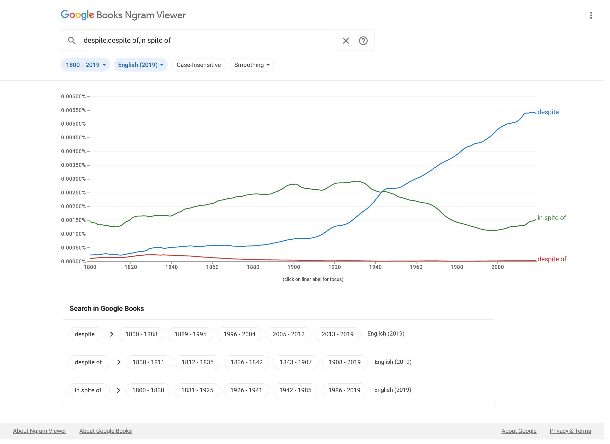
Using Ngram Viewer

Slide 16
Information on words and phrases in Ngram Viewer

Slide 17
A search in MICUSP
Research occurs 1959 times in 328 papers
Researches occurs only 12 times in 8 papers.
Some instances of researches might be spelling errors (researchers) or the third person singular form of the verb research
Researchers occurs 366 times in 103 papers.
You can narrow the search by student level, nativeness, text type, paper type or discipline.

Slide 18
Searching COCA
experience/experiences?
Which word, experience or experiences, is more common in academic writing?
Searching a word in the Academic Vocabulary List
Search by lemma or word family
Find relative frequency and distribution
See topics, collocates, synonyms, n-grams, concordance lines etc.

Slide 19
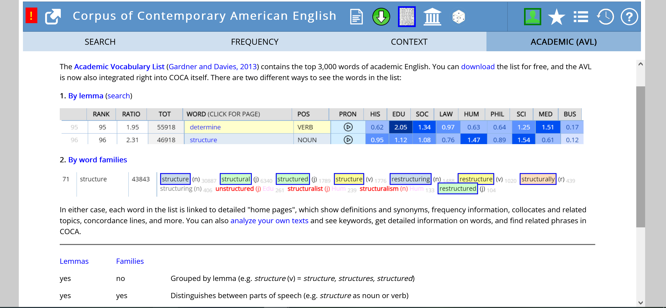

Slide 20
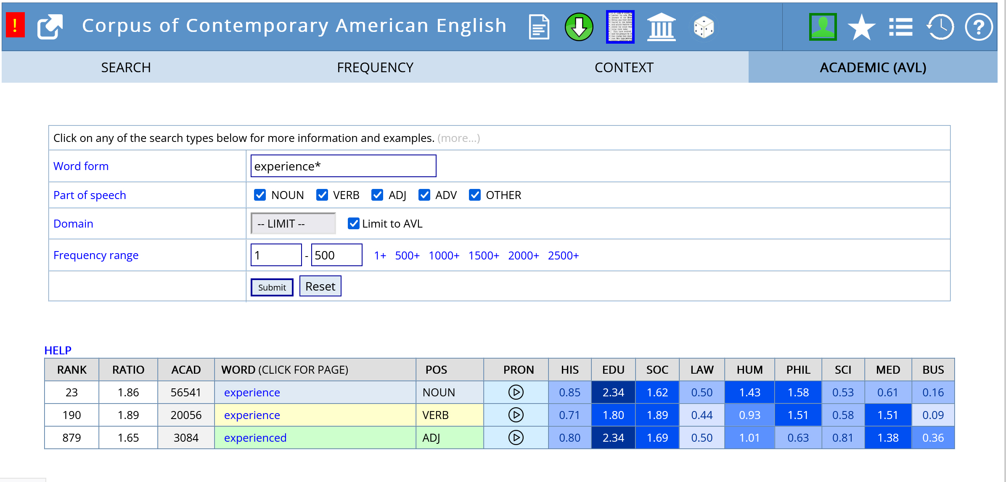

Slide 21
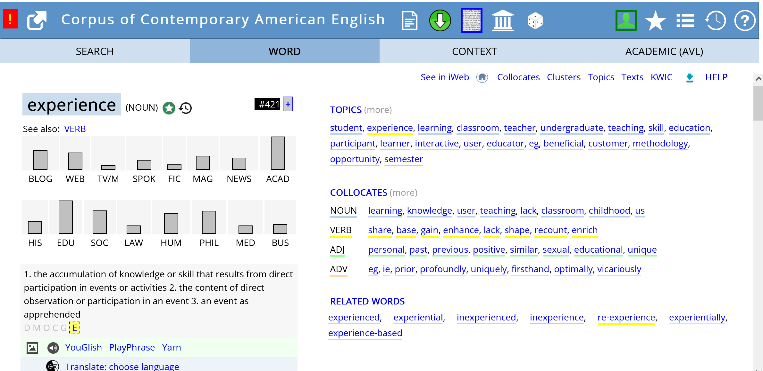

Slide 23
Analyzing student writing
experience/experiences?
How many words has a student used from the most common words in English?
How many words has a student used from the Academic Word List (AWL) or the Academic Vocabulary List (AVL)?
Have they used a lot of repetition?
Have they used appropriate synonyms?
COCA Academic
Upload texts to website
Check word and phrase info
Create wordlists
Compare drafts
+ easy to use
- Need to register
AntWordProfiler
Load texts to software on own computer
Check percentage use of AWL
Create wordlists
Compare drafts
+Free software- How-to videos on YouTube
- Must convert texts to .txt format

Slide 24
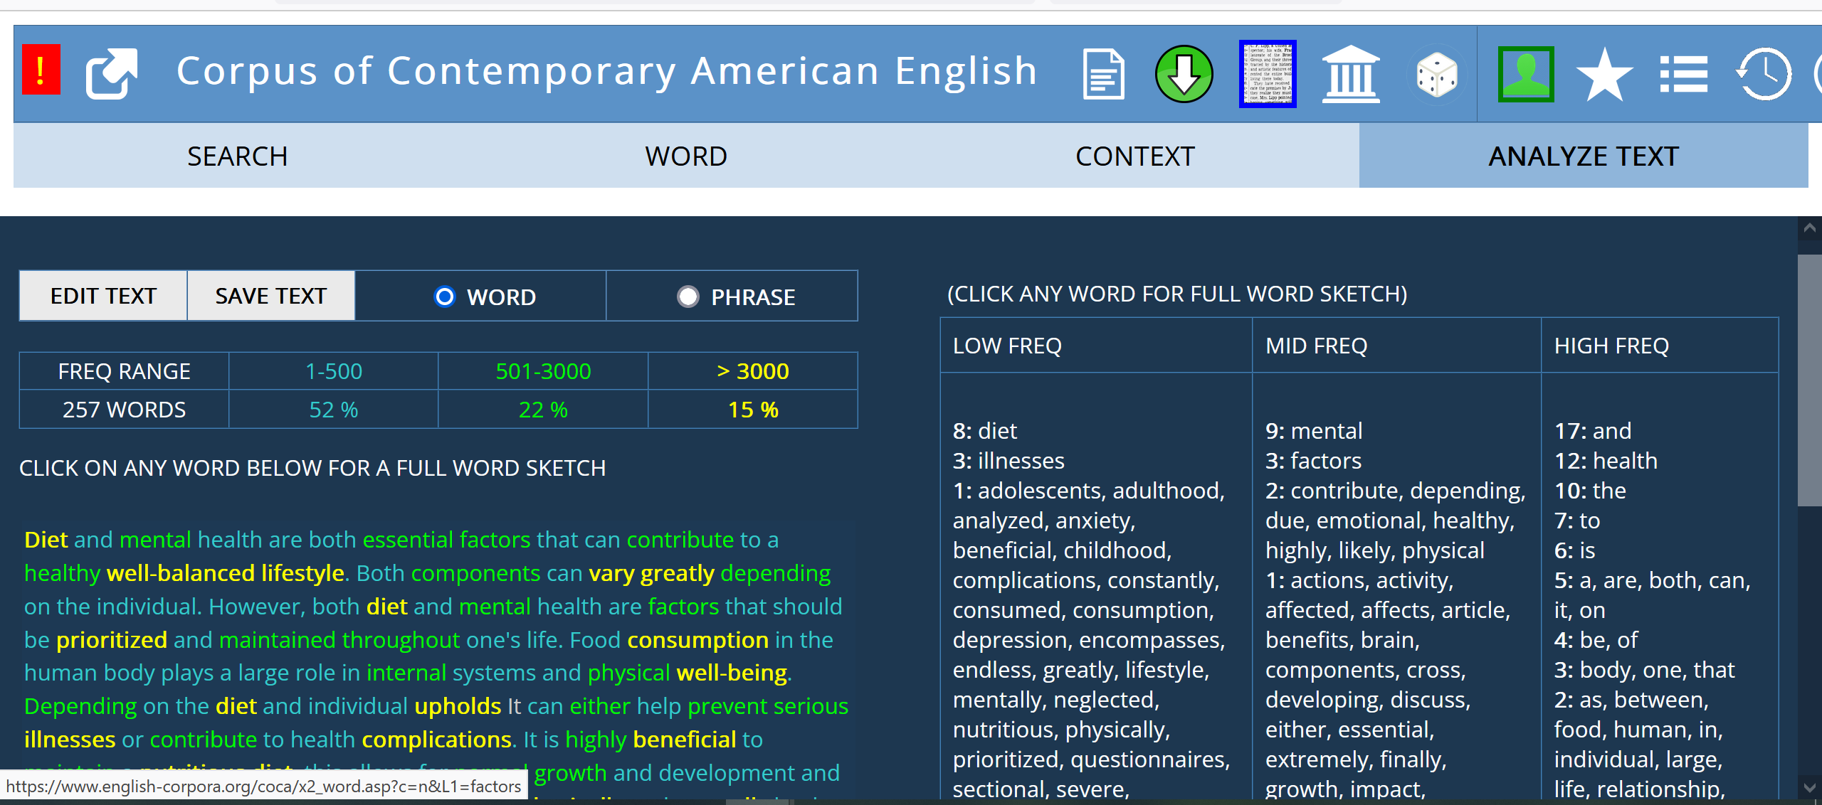

Slide 25
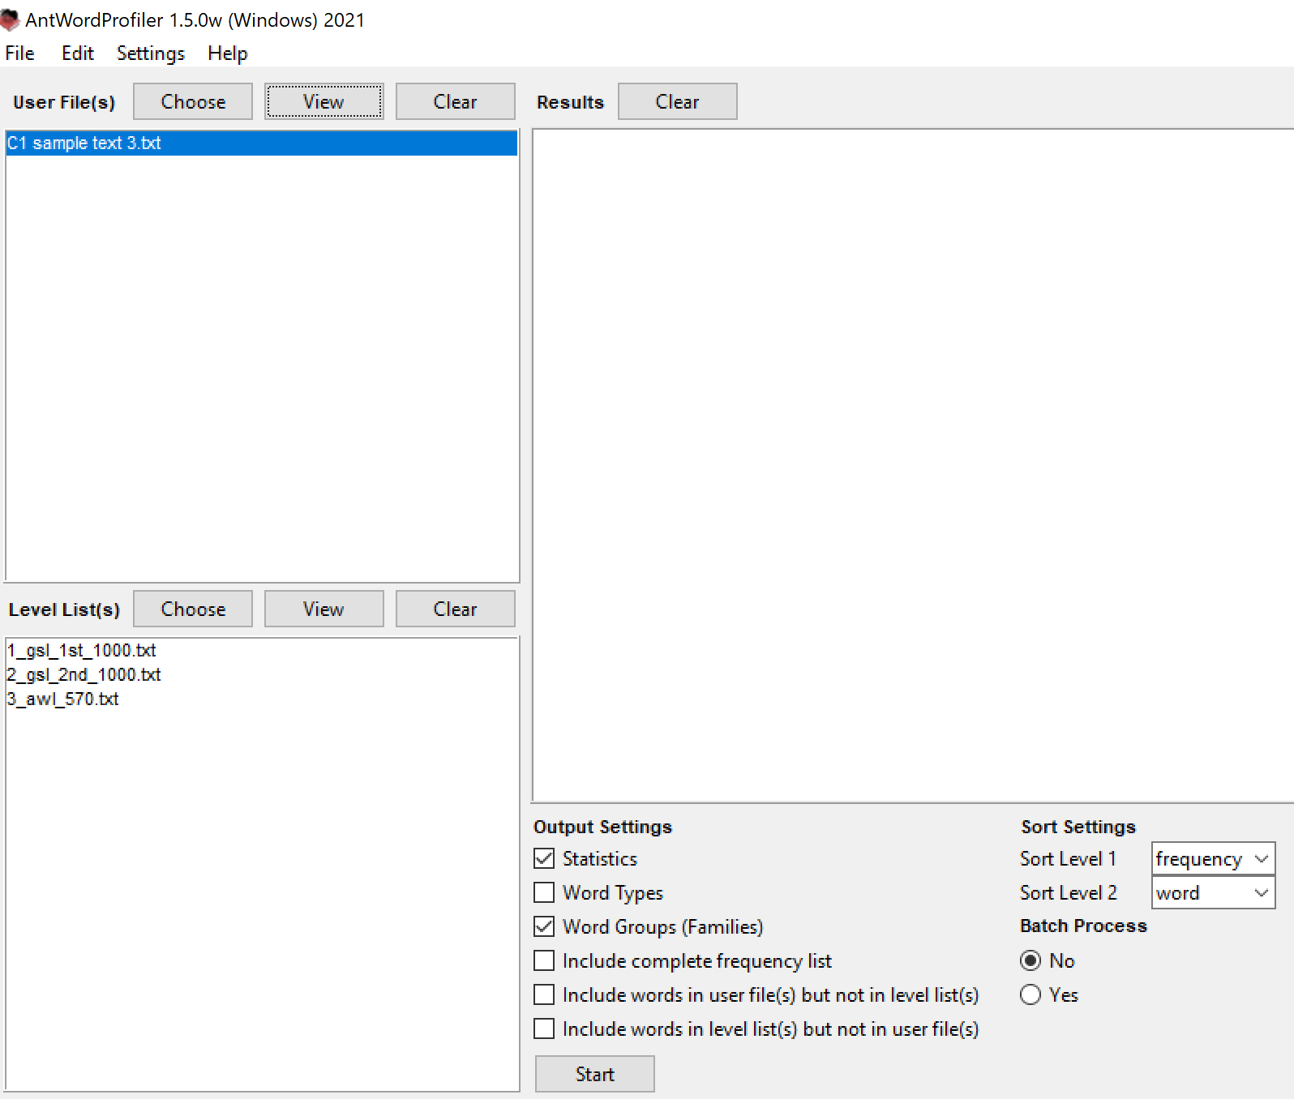
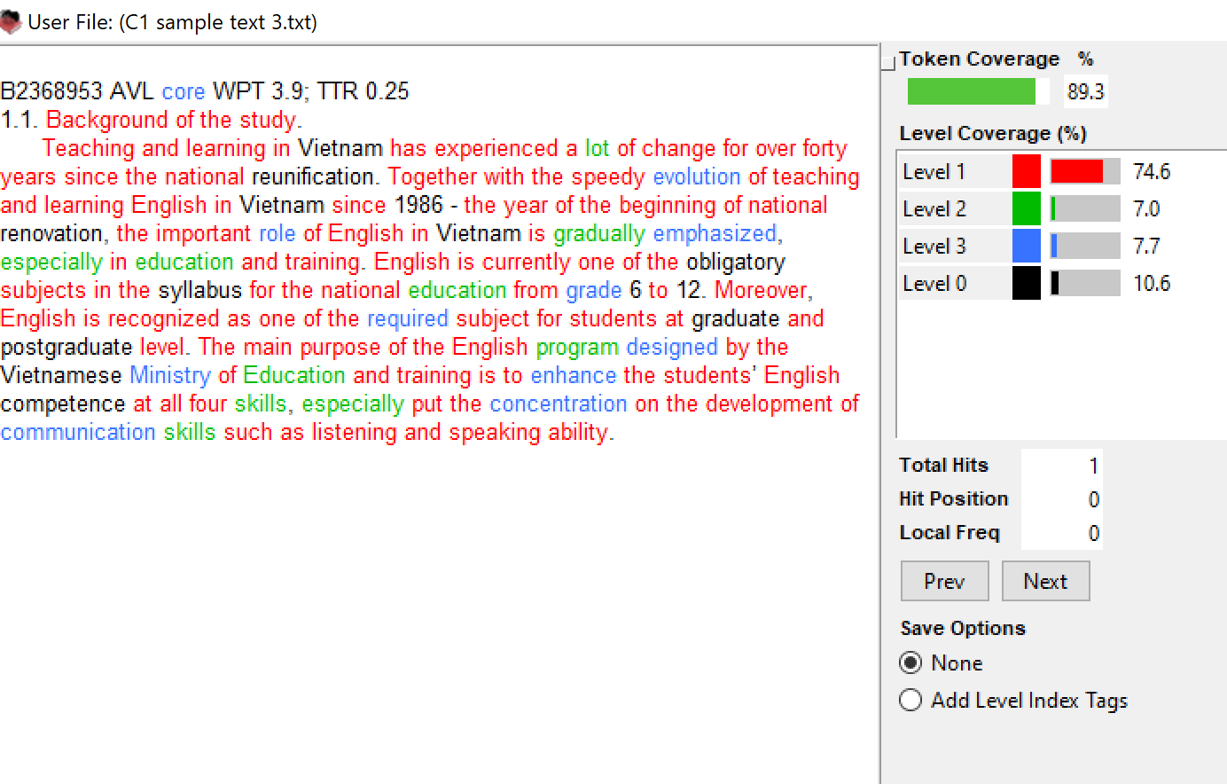
http://www.laurenceanthony.net/software/antwordprofiler/
RESULTS

Slide 26
Using existing materials
Textbooks based on corpus data
Cambridge University Press: textbooks such as the Vocabulary in Use series based on Cambridge English Corpus of written and spoken English, includes Cambridge Learner Corpus of exam papers.
(The Webinar- Using corpora for academic English by Michael McCarthy is a great introduction to using corpora)
https://www.youtube.com/watch?v=fkAq7NtGIjA
University of Michigan Press: e.g., Grammar Choices for Graduate and Professional Writers by Nigel Caplan) based on MICUSP and COCA.
Longman: Longman Student Grammar of Spoken and Written English and workbook by Biber, Conrad, and Leech. Examples from 40 mil. word corpus of BR and AM Eng.
DDL online materials informed by corpora
Compleat Lexical Tutor https://www.lextutor.ca/ based on Brown corpus and other corpora.

Slide 27
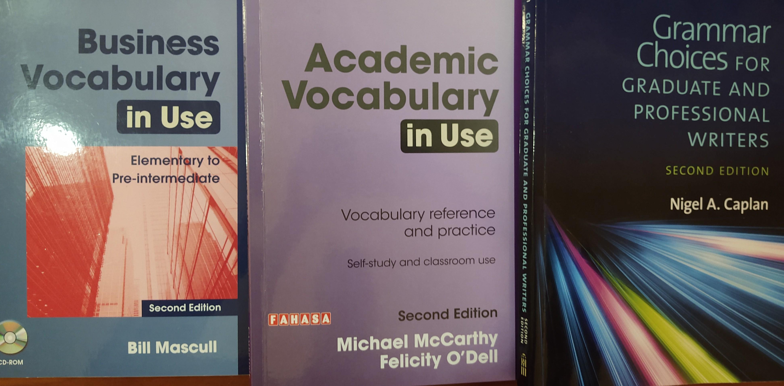

Slide 28
Exercises from Academic Vocabulary in Use (McCarthy and O’Dell, 2016)

Slide 29
Free tools for analyzing student writing
Analyze my writing.com https://www.analyzemywriting.com/index.html
Students can upload own or other texts
Compare drafts for lexical density, sentence length, use of passive voice, and readability (but this is controversial)
Note: The analysis does not measure what is a “good” text; it needs interpretation.
AntWordProfiler http://www.laurenceanthony.net/software/antwordprofiler/
Discover what percentage of words in a text are from the General Service List (GSL) and the Academic Wordlist (AWL).
Make wordlists for study.
Compare texts including own drafts (convert texts to .txt format before use).
AntConc http://www.laurenceanthony.net/software/antconc/
A powerful and fast tool for more sophisticated text analysis and concordancing
There are links to very good how-to videos on the website.

Slide 30
Caveats
Computers will continue to dominate every aspect of our lives, and web-based teaching and learning applications will grow.
Teachers and learners need to be critical consumers.
Need to balance hype with reality, costs with benefits
Not every learning experience is better with DDL
Corpora can tell us what people have said/written NOT what is possible to say/write
Students will demand more access to authentic data, but they need to learn how to search and interpret findings.
Corpus searches do not tell us what word or phrase is better in terms of style or persuasiveness - only how frequent and how dispersed.
Concordance lines show words/phrases in context, and collocates, but not whether usage reflects prescriptive grammar rules (which is important to point out.)

Slide 31
Some concerns about DDL
Dangers for students working independently
May not correctly interpret results
May be overwhelmed by the sheer volume of data
May get distracted from the original task, and waste time
May be overwhelmed by technical aspects of searching
Solutions
Training for teachers and students is essential
Regular use creates familiarity
Embed corpus-informed tasks in every teacher training course
Build DDL into syllabi and teaching methodologies

Slide 32
Prospects
“Digital tools for learning have become integrated elements ‘both in the real world and also in foreign language syllabuses.’ ” (Davies, Otto & Rüschoff, 2013: 34, cited in Pérez-Paredes (2022)
But… a recent survey of 230 mostly higher education (44%) and secondary (23%) language teachers in Spain and the UK. (2018) showed around 70% of the teachers used either online platforms or web-based services in their everyday teaching. But only a small number were familiar with L1 corpora or learner corpora in language teaching (Pérez-Paredes et al.2018, cited in Pérez-Paredes, 2022.)
DDL is switching focus from corpus linguistics to language pedagogy, and the emphasis is increasingly on L2 users and less on the technology itself (Boulton & Pérez-Paredes, 2014.)
DDL needs to become “normalized” in the classroom (Pérez-Paredes, 2022)
The technology interface needs to be easier for learners to navigate so they can place attention on learning, not technology.
Teachers need professional development and students need training for DDL to reach its full potential as a tool for teaching and learning.

Slide 33
Thank-you!
Questions and Discussion

Slide 34
References
Biber, D., Conrad, S. & Leech, G. (2002). Longman Student Grammar of Spoken and Written English, Harlow, England: Longman. ISBN 978-0-582-23726-1
Boulton, A. (2012). Hands-on/hands-off: Alternative approaches to data-driven learning. In J. Thomas & A. Boulton (eds), Input, Process and Product: Developments in Teaching and Language Corpora. Brno: Masaryk University Press. 152-168.
Caplan, N. (2012). Grammar choices for graduate and professional writers. 2nd ed. University of Michigan Press.
Cheng, W. (2010) What can a corpus tell us about language teaching? in O'Keeffe, A., & McCarthy, M. (Eds.). (2010). The Routledge Handbook of Corpus Linguistics. Taylor & Francis Group 319-332.
Cobb, T. & Boulton, A. (2015). Classroom applications of corpus analysis. In D. Biber & R. Reppen (eds), Cambridge Handbook of English Corpus Linguistics. Cambridge: Cambridge University Press, p. 478-497. DOI:10.1017/CBO9781139764377.027
Gollin-Kies, S., Kies, D. & Mozafari, C. (2016, April). Corpus-based approaches to writing. (Workshop presentation). Conference on College Composition and Communication, Houston, Texas. https://rhetory.com/cccc2016/sota.htm

Slide 35
References contd.
Johns, T. (1991) ‘From Printout to Handout: Grammar and Vocabulary Teaching in the Context of Data-driven Learning’, English Language Research Journal 4: 27–45.
Lee, H., Warschauer, M., & Lee, J. H. 2018. The Effects of Corpus Use on Second Language Vocabulary Learning: A Multilevel Meta-analysis. Applied Linguistics. DOI: https://doi.org/10.1093/applin/amy012
McCarthy, M. & O’Dell, F. (2016) Academic Vocabulary in Use. 2nd ed. Cambridge University Press.
Pérez-Paredes, P. (2022). A Systematic Review of the Uses and Spread of Corpora and Data-Driven Learning in CALL Research during 2011-2015. Computer Assisted Language Learning, v35 n1-2 p36-61
Tognini-Bonelli, E. (2001). Corpus linguistics at work. John Benjamins Publishing Company

Slide 36
A (non-representative) selection of smaller-scale studies
Bardovi-Harlig,K., Mossman, S., & Vellenga, H. E. (2015). The effect of instruction on pragmatic routines in academic discussion. Language Teaching Research : LTR, 19(3), 324–350. https://doi.org/10.1177/1362168814541739
Charles, M. (2014). Getting the corpus habit: EAP students’ long-term use of personal corpora. English for Specific Purposes (New York, N.Y.), 35, 30–40. https://doi.org/10.1016/j.esp.2013.11.004
Dolgova, N. & Mueller, C. (2019). How useful are corpus tools for error correction? Insights from learner data. Journal of English for Academic Purposes, 39, 97–108. https://doi.org/10.1016/j.jeap.2019.03.007
Hasselgren, A. (1994). Lexical teddy bears and advanced learners: A study into the ways Norwegian students cope with English vocabulary. International Journal of Applied Linguistics, 4(2), 237–258
Jin,T. & Lu, X. (2018). A Data-Driven Approach to Text Adaptation in Teaching Material Preparation: Design, Implementation, and Teacher Professional Development. TESOL Quarterly, 52(2), 457–467. https://doi.org/10.1002/tesq.434
Leedham, M. & Cai, G. (2013). Besides … on the other hand: Using a corpus approach to explore the influence of teaching materials on Chinese students’ use of linking adverbials. Journal of Second Language Writing, 22(4), 374–389. https://doi.org/10.1016/j.jslw.2013.07.002
Liu, D. & Jiang, P. (2009). Using a Corpus-Based Lexicogrammatical Approach to Grammar Instruction in EFL and ESL Contexts. The Modern Language Journal (Boulder, Colo.), 93(1), 61–78. https://doi.org/10.1111/j.1540-4781.2009.00828.x

