Slide 1
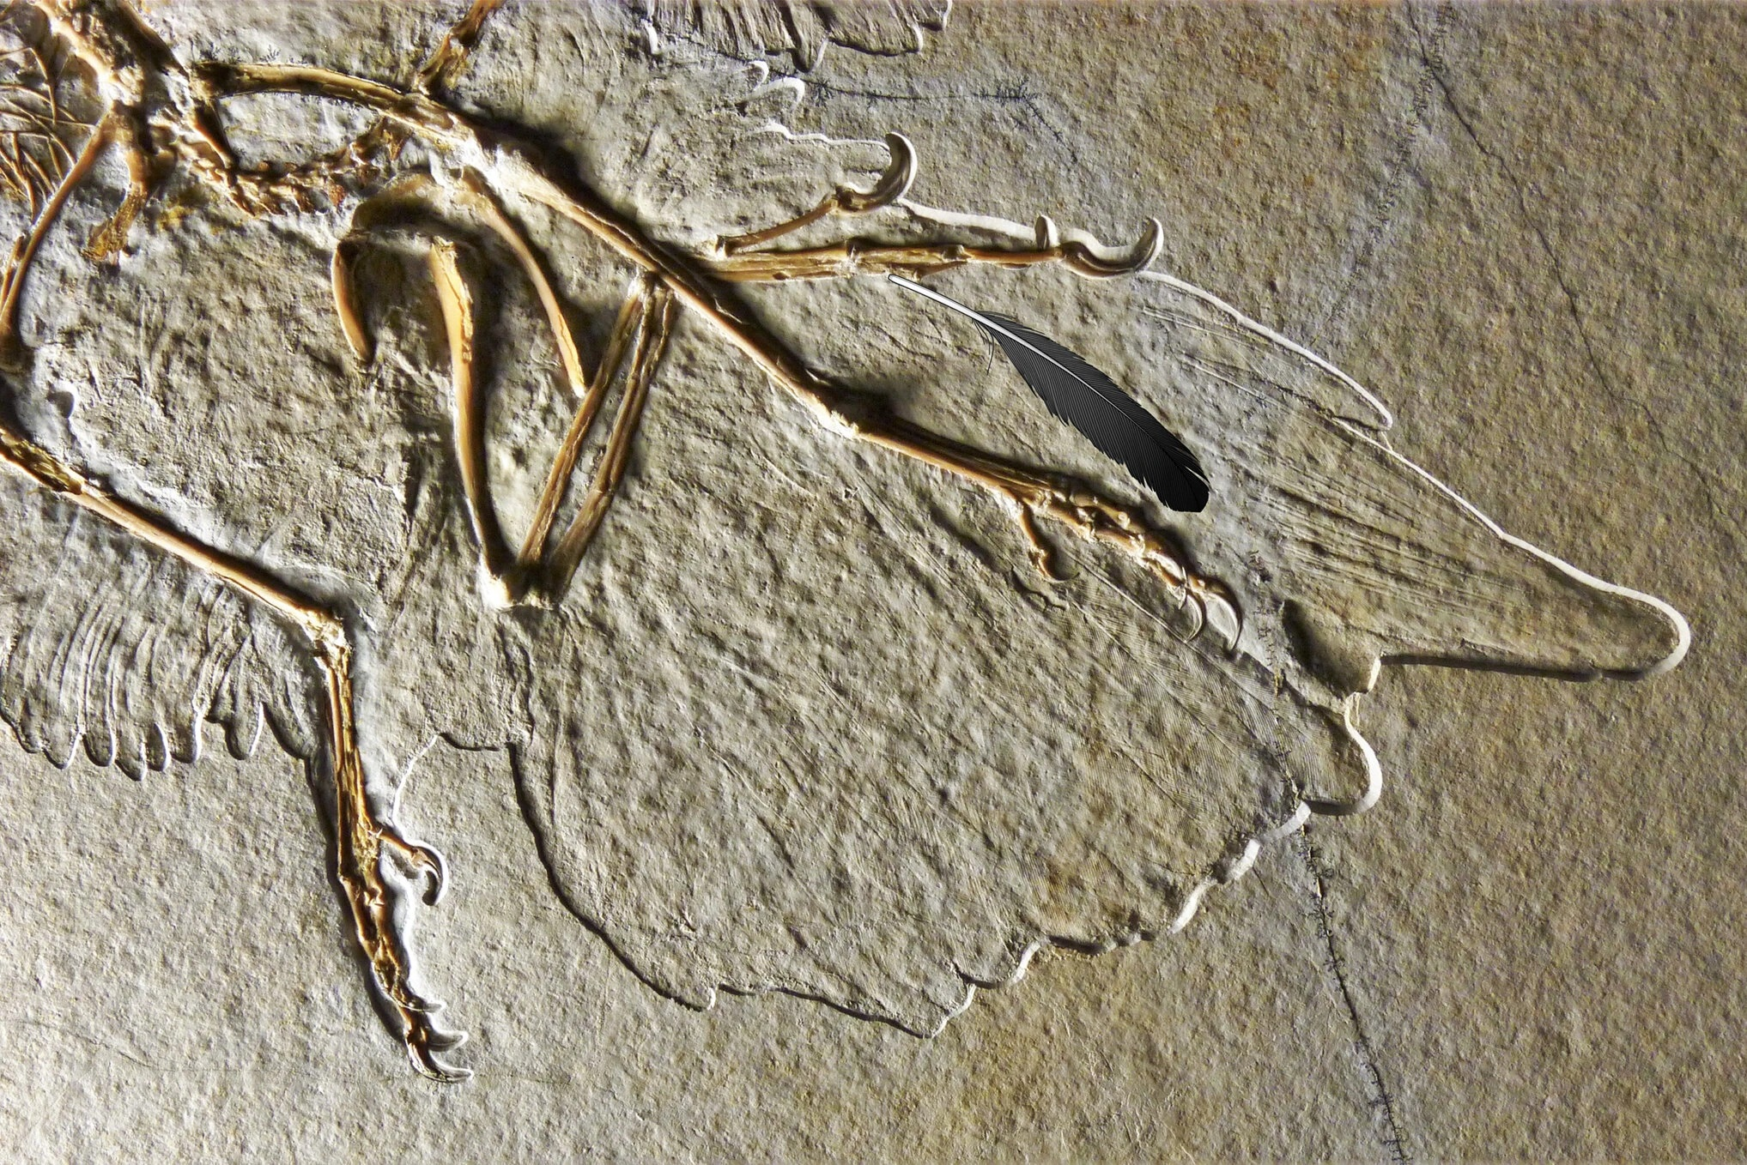
Published Writing Advice: Take with a Grain of Salt?
WAC Nov 17, 2020.
Prof. Sandra Kies

Slide 2
In this presentation, I will analyze the viability of common writing advice for students in academic writing situations.
I will argue that popular writing advice is not appropriate to all student writing situations; instead, the writing advice needs to be evidence-based and appropriate to the purposes and audience of the writer.

Slide 3
Advice from Strunk and White*
Use the active voice. There were a great number of dead leaves lying on the ground -> Dead leaves covered the ground (p. 19.)
Write with nouns and verbs, not with adjectives and adverbs (p.71.)
Avoid the use of qualifiers. Rather, very, little, pretty “leeches that infest the pond of prose, sucking the blood of words” (p. 73.)
In summaries, keep to one tense. “Shifting from one tense to another gives the appearance of uncertainty and irresolution” (p. 31)
Put statements in a positive form. “Make definite assertions. Avoid tame, colorless, hesitating noncommittal language” (p. 19.)
Use definite, specific, concrete language. “Prefer the specific to the general, the definite to the vague, the concrete to the abstract” (p.21.)
*(2000) 4th edition.

Slide 4
Strunk and White contd.
Place the emphatic words of a sentence at the end. “The proper place… for the word or group of words that the writer desires to make most prominent is usually at the end.” “…that is, the new element…” “To receive special emphasis, the subject of a sentence must take the position of the predicate (p. 33.)
Do not affect a breezy manner “often the work of an egocentric – uninhibited prose [that] creates high sprits…uses slang…patronizing…dull” (p.73.)
Do not inject opinion (p.79.)
Avoid fancy words. “Anglo-Saxon is a livelier tongue than Latin, so use Anglo-Saxon words” (p.77.)

Slide 5
“Bits and pieces” from William Zinsser*
Verbs: use active verbs unless there is no comfortable way to get around using a passive verb…Joe hit him is strong. He was hit by Joe is weak. “Active verbs give vitality and flair to the written word.”
Adverbs: “Most adverbs are unnecessary.” e.g. He moped dejectedly.
Little qualifiers: “Every little qualifier whittles away some fraction of trust on the part of the reader. He wants a writer who believes in himself and what he is saying.”
Contractions. “Your style will obviously be warmer and truer to your personality if you use contractions like I’ll and won’t.”
Concept nouns. Avoid abstract nouns. Use “real” people and “real” verbs.
Creeping nounism. “A new American disease that strings two or three nouns together where one will do.”
(1985) Ch. 14.

Slide 6
“Some special problems” from Joe Williams*
Put your audience into the sentence as subject-agents or object-goals.
Make their crucial actions verbs.
Keep your sentences relatively short, from 15-18 words.
Use words that are concrete, specific; use few abstract nouns.
Put important information at the end of your sentences, never buried in the middle;
Make the topics of your sentences consistent.
* (1981, p. 109)

Slide 7
Some general advice from Zinsser on style*
“If all your sentences move at the same plodding gait, which even you recognize as deadly but don’t know how to cure, read them aloud. (I write entirely by ear and read everything aloud several times before letting it go out into the world.) You will begin to hear where the trouble lies. See if you can gain variety by reversing the order of a sentence, or by substituting a word that has freshness or oddity, or by altering the length of your sentences so that they don’t all sound as if they came out of the same mold. An occasional short sentence can carry a tremendous punch. It stays in the reader’s ear.”
Compare the following two texts…
*William Zinsser. On Writing Well. Harper Perennial, 1990: 39-40.

Slide 8
Let’s turn to some data: Text A
The feather looks like any feather you might find on the ground. But it’s not. It’s about 150 million years old, and it fluttered to the ground back when the dinosaurs roamed what is today called Bavaria. It’s entombed in limestone, and, when paleontologists unearthed it in 1861, it became the first fossil feather ever discovered.
Many paleontologists think the feather came from archaeopteryx lithographica, a creature that, with its feathered wings and sharp-toothed mouth, bears features of both dinosaurs and birds, making it a herald of the evolutionary transition between the two groups.
*https://www.nytimes.com/2020/09/30/science/dinosaur-feather-fossil-archaeopteryx.html?action=click&block=more_in_recirc&impression_id=74ec08b3-069d-11eb-a037-6b7c869938f9&index=4&pgtype=Article&region=footer

Slide 9
More data: Text B
The historic fossil feather from the Jurassic Solnhofen has played a pivotal but controversial role in our evolutionary understanding of dinosaurs and birds. Recently, a study confirmed the diagnostic morphology of the feather’s original calamus, but nonetheless challenged the proposed identity as an Archaeopteryx covert. However, there are errors in the results and interpretations presented. Here we show that the feather is most likely an upper major primary covert, based on its long calamus (23.3% total length) and eight other anatomical attributes. Critically, this hypothesis is independently supported by evidence of similar primary coverts in multiple specimens of Archaeopteryx–including from the same fossil site and horizon as the isolated feather.
Carney, R.M., Tischlinger, H. & Shawkey, M.D. Evidence corroborates identity of isolated fossil feather as a wing covert of Archaeopteryx. Sci Rep 10, 15593 (2020). https://doi.org/10.1038/s41598-020-65336-y
OED. Ornith. Calamus: The lower, unbarbed part of the shaft of a bird's feather; Covert: feathers of the wings and tail.

Slide 10
Genre
A Genre is a “staged, goal-oriented, purposeful activity in which speakers engage as members of our culture” (Martin, 2001:155)
There are many different “genres” on a cline from informal (e.g. conversational) to formal (e.g. academic, legal etc.)
Text A: The lead for a NYT article reporting on science for a general, but “educated” audience. Starts with a “hook” that leads into an extended summary of the scientific report.
Text B: Abstract (summary) of a journal article to inform scientific peers who expect IMRD structure.

Slide 11
Same topic, different purpose and audience leads to different choices in grammar, vocabulary and organization of ideas.
Text A: “general” audience
Text B: Scientific audience
Pronouns (you)
“Everyday” vocabulary (you might find on the ground)
Conversational (back when the dinosaurs roamed)
Lacks specificity (any feather; many paleontologists think)
Contractions (it’s)
Active voice (paleontologists unearthed it)
“Lively” description (it fluttered to the ground)
Varied sentence length: short (But it’s not) and long with complex embedding.
Pronouns? (we and our)
Technical terms (calamus; covert)
Carefully “hedges” claims (most likely )
Complicates the issues (a pivotal but controversial role … but nonetheless challenged the proposed identity)
Complex noun phrases (the diagnostic morphology of the feather’s original calamus)
Passive voice? (Critically, this hypothesis is independently supported by evidence)
Many overt discourse markers (recently, however, critically)

Slide 12
How useful is Zinsser’s advice?
read them aloud. (I write entirely by ear and read everything aloud several times before letting it go out into the world.) You will begin to hear where the trouble lies.
gain variety by reversing the order of a sentence,
by substituting a word that has freshness or oddity,
or by altering the length of your sentences so that they don’t all sound as if they came out of the same mold. An occasional short sentence can carry a tremendous punch. It stays in the reader’s ear.”

Slide 13
Reversing the order of a sentence changes information flow and reader expectations
Information flows from given to new information.
The principle of end weight says whatever comes towards the end of the sentence has information prominence.
Using passive voice – shifts emphasis, changes reader expectations
Paleontologists studied the structure of the feather. -> expect more on the structure
The structure of the feather was studied to determine its identity -> expect more on the process of identification of the feather.
“Marked themes” can also direct the information flow.
It was the re-analysis of the feather that excited paleontologists. -> What did paleontologists find exciting about the re-analysis?
What excited paleontologists was the re-analysis of the feather. -> What did re-analysis reveal?

Slide 14
Reversing the order of some sentences subtly changes the message.
The historic fossil feather from the Jurassic Solnhofen has played a pivotal but controversial role in our evolutionary understanding of dinosaurs and birds. Recently, a study confirmed the diagnostic morphology of the feather’s original calamus, but nonetheless challenged the proposed identity as an Archaeopteryx covert.
Our evolutionary understanding of dinosaurs and birds has been complicated by the discovery of historic fossil feather from the Jurassic Solnhofen. Its identity as an Archaeopteryx covert has been challenged by a study of the morphology of the feather’s original calamus.

Slide 15
“Write with nouns and verbs, not with adjectives and adverbs” (Strunk and White)
Data on frequency of word classes across registers
(broad categories of text)
(Biber, Conrad & Leech, 2002).

Slide 16
Keep your sentences relatively short (Williams)
Informal conversation and formal written English are very different
Biber, Gray and Poonpon (2011) in a corpus-based study contrasted 28 grammatical features in both research articles and conversation.
They showed subordinate clauses are more common in conversation than in academic writing.
Fundamentally different kinds of grammatical complexity are common in academic writing: complex noun phrases and other complex phrases rather than clauses.
That means sentences in academic writing can be very long (extended using embedded phrases and clauses) but may not contain a lot of subordinate clauses.
Conversation is not a good model for academic writing; to advise a student to write as they speak is poor advice, unless they “speak like a book.”

Slide 17
Some published advice seems to be rooted in rhetoric
Based on the study of spoken argumentation started by the Greeks.
“Rhetors” carefully craft their speeches. Ideas composed in literate text, closely edited, use mnemonic devices such as alliteration and parallelism to cement ideas in the mind (e.g. Declaration of Independence – written to be orated? )
Social purpose (e.g. persuade, argue, explain, describe, analyze, deceive)
Audience (“Friends, romans, countrymen” vs “fellow senators”)
Anticipated organizational structure (generic staging)
Other published advice….???

Slide 18
A final word about Language Mavens* (from the Yiddish word for “expert”)
The wordwatchers “train their binoculars on the especially capricious eccentric, and poorly documented words and idioms that get sighted from time to time” (p. 396.)
“when we want to irritate someone, why do we say we want to get his goat?”
The Jeremiahs “expressing their bitter laments and righteous prophecies of doom” (p. 398.) i.e. The language is going to the dogs (my comment.)
The entertainer “who shows off his collection of palindromes, puns, anagrams, rebuses, malapropisms, Goldwynisms, sesquipedalia, howlers and bloopers” e.g. Richard Lederer in The Joy of Lex (p. 399.)
“In accordance with your instructions I have given birth to twins in the enclosed envelope.”
The sage “known for taking a moderate, common sense approach to matters of usage.” (e.g. William Safire’s column in New York Times Magazine focuses on usage issues such as errors in whom, which, and personal pronouns (p. 402.)
“Who’re you gonna call? GHOSTBUSTERS!” -> “Whom are you going to call?
* Steven Pinker, 1994, Chap. 12.)

Slide 19
Some last thoughts
Some critiques of Strunk and White: https://en.wikipedia.org/wiki/The_Elements_of_Style
In 2016, the Open Syllabus Project lists The Elements of Style as the most frequently assigned text in US academic syllabuses, based on an analysis of 933,635 texts appearing in over 1 million syllabuses.
Geoffrey Pullum, professor of linguistics at the University of Edinburgh, and co-author of The Cambridge Grammar of the English Language (2002) calls Strunk and White: "the book that ate America's brain.“
The book's toxic mix of purism, atavism, and personal eccentricity is not underpinned by a proper grounding in English grammar. It is often so misguided that the authors appear not to notice their own egregious flouting of its own rules ... It's sad. Several generations of college students learned their grammar from the uninformed bossiness of Strunk and White, and the result is a nation of educated people who know they feel vaguely anxious and insecure whenever they write however or than me or was or which, but can't tell you why.
Joe Williams (Preface - To teachers):
Is there any point addressing a problem that does not yet affect your students?
“To assume that we should not address a problem before it arises is a little bit like teaching birth control after the rabbit dies.”

Slide 20
Discussion?
First, do no harm?
But can we do better?
Thank you!
skies@ben.edu
https://rhetory.com/
https://papyr.com/hypertextbooks/

Slide 21
References
Biber, D., Conrad, S., & Leech, G. (2002). Longman Student Grammar of Spoken and Written English, Harlow, England: Longman.
Biber, D., Gray, B., & Poonpon, K. (2011). Should We Use Characteristics of Conversation to Measure Grammatical Complexity in L2 Writing Development? TESOL Quarterly, 45(1), 5-35. Retrieved November 15, 2020, from http://www.jstor.org/stable/41307614
Martin, J.R. (2001) Language, register and genre. In A. Burns and C. Coffin (eds). Analyzing English in a global context. London: Routledge.
Pinker, S. (1994)The language instinct: How the mind creates language. NY: Harper Perennial.
Pullum, G. K. (2009) 50 Years of Stupid Grammar Advice. Chronicle of Higher Education. April 17.
Strunk. W. (Jnr.) and E.B. White (2000) The Elements of Style 4th Ed. New York: Longman.
Williams, J. (1985) Style: Ten lessons in clarity and grace. 2nd Ed. Glenview Il.: Scott, Foresman and Co.
Zinsser, W. (1990) On writing well: An informal guide to writing nonfiction. NY: Harper Perennial.

