Slide 1
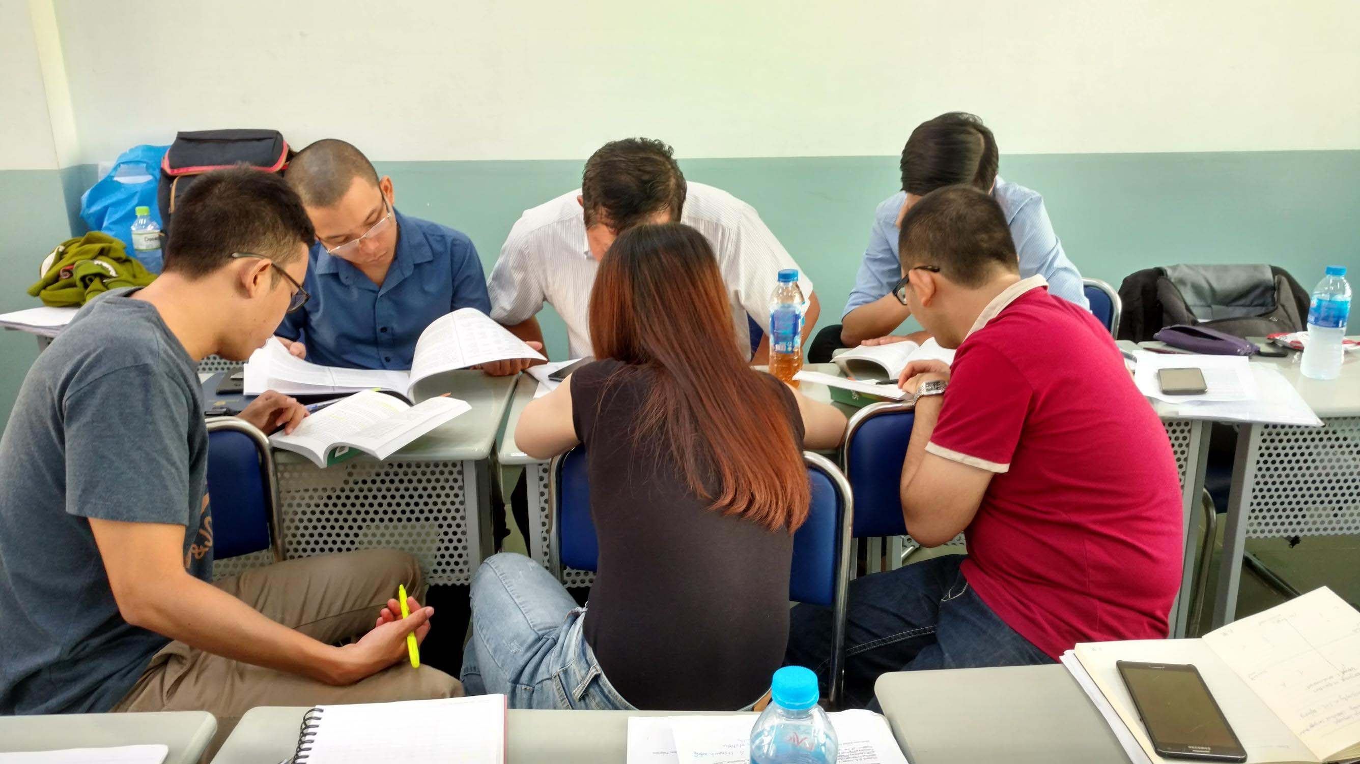
Acquiring a scholar’s voice: Vietnamese students mastering academic vocabulary in thesis writing
Sandra Kies PhD
Benedictine University
Lisle, Illinois, USA.
WRAB V (online) 5 March 2021

Slide 2
The Research Project
Aims to inform writing pedagogy in English for Academic Purposes with the goal of developing more targeted instruction in using academic vocabulary in context.
This paper presents mostly quantitative data on a small sub-section of an ongoing mixed methods (Riazi and Candlin, 2014) longitudinal study on academic writing by 43 graduate students writing theses as part of an MA in Linguistics (TESOL), in English, in Vietnam.
Vocabulary research questions
  What is the vocabulary level of students at the beginning of the thesis writing process compared with reference corpora?
  How much change in vocabulary use occurs over the period of drafting? (6mths to one year).
  What changes have occurred?
  What does this say about our scaffolded thesis writing process with respect to developing academic vocabulary in a discipline?

Slide 3
Method
Here I focus on one aspect, the development of academic vocabulary, comparing students’ control over words in the New Academic Vocabulary List (NAVL) (Gardner & Davies, 2014)
So far, analysis has focused only on the draft and final versions of the theses’ introductions discussions and conclusions. These sections are considered most likely to contain students’ most diverse vocabulary, with less reliance on the vocabulary of source texts, or the more formulaic vocabulary found in methods and findings section.
Previously graded texts were anonymized, and analyzed both individually and collectively, using Laurence Anthony’s Antwordprofiler and compared for frequency of lemmas (both core vocabulary and technical vocabulary) listed in the New Academic Vocabulary List (Gardner and Davies, 2014.)
Student files were compared against two reference corpora: The linguistics subcorpus of the BAWE Corpus of student academic Writing, and COCAA 2010-12 (a subset of COCA)
Education and Humanities and Social Sciences lemmas were drawn from the NAVL to make comparisons between the reference corpora and VNL students writing.

Slide 4
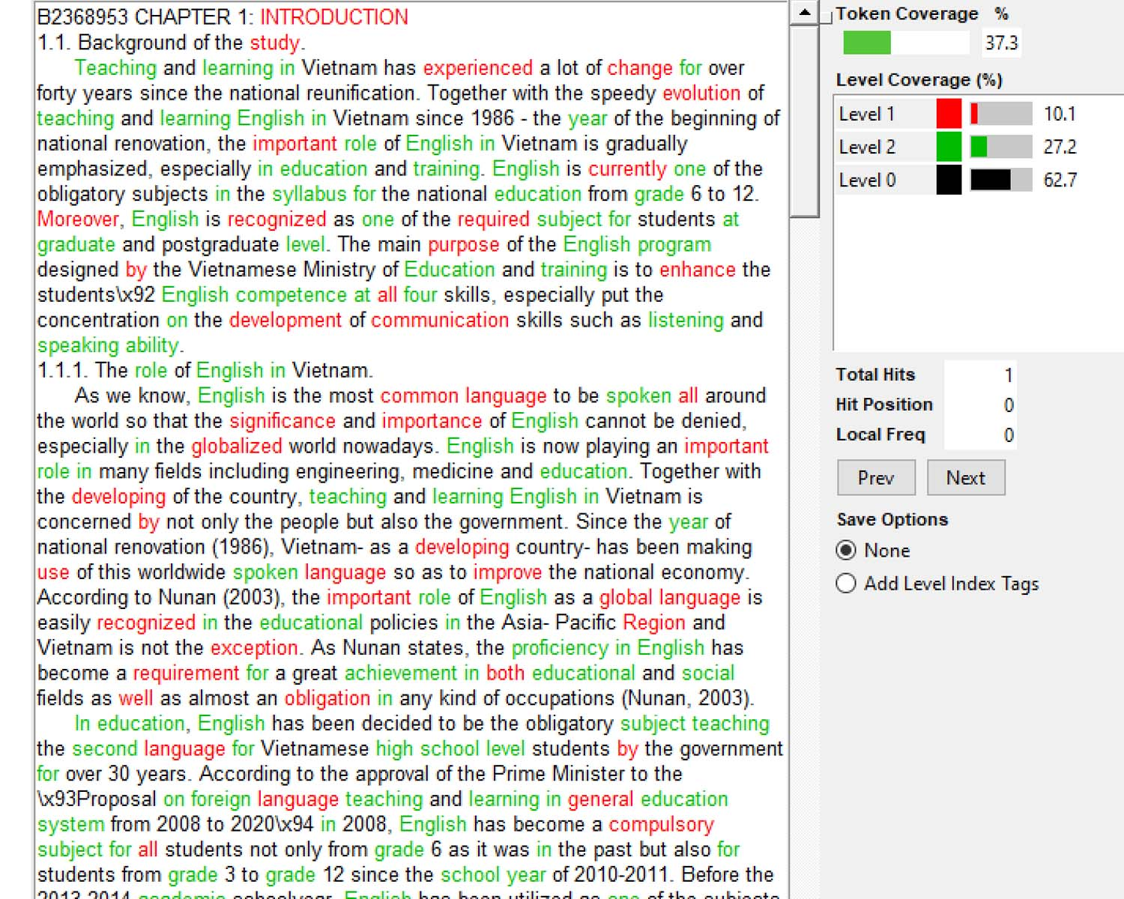
Student writing sample VNL C1 first draft
(using Antwordprofiler and NAVL wordlists)

Slide 5
Reference corpora
BAWE linguistics subcorpus: graduate student papers (31 students; 88,433 words) – level 4 - most comparable to VNL students
  NS English L1 (38,222 words)
  NNS L1 other than English - living and studying in England- immersed in target language. (50,211 words)
An academic sub-set of COCA- Corpus of Contemporary American English, 2010-2012 (9,588,174.) Consists of whole papers including reference lists.
  Many disciplines; wider range of technical words than VNL texts.
  Gives a reference point for target professional writing.

Slide 6
Comparing draft Intro, Discussion and Conclusions in VNL C1-3 (Antwordprofiler)
Lexical Profile Statistics | Lexical Profile Statistics |  | C1-3 all first drafts
 | LEVEL | FILE | TOKEN | TOKEN% | TYPE | TYPE%
 | 2 | NAVL-core-academic.txt | 14567 | 13.96 | 1104 | 18.25
 | 3 | NAVL-discipline-selectedacademic.txt | 18582 | 17.8 | 514 | 8.5
 | 0 | - Other words in top 20,000 | 66746 | 63.95 | 3863 | 63.86
 | TOTAL | 104,373 | 99895
Lexical Profile Statistics | Lexical Profile Statistics |  | C1-3 all final drafts
 | LEVEL | FILE | TOKEN | TOKEN% | TYPE | TYPE%
 | 2 | NAVL-core-academic.txt | 23669 | 14.06 | 1219 | 17.57
 | 3 | NAVL-discipline-selected-academic.txt | 30347 | 18.03 | 555 | 8
 | 0 | -Other words in top 20,000 | 106915 | 63.52 | 4515 | 65.08
 | TOTAL | 168,325 | 160931

Slide 7
BAWE Lexical Profiles
(Antword profiler)
Lexical Profile Statistics BAWE NS linguistics
LEVEL | FILE | TOKEN | TOKEN% | TYPE | TYPE%
1 | NAVL-core-academic.txt | 6071 | 15.88 | 1036 | 22.7
2 | NAVL-discipline-selected-academic.txt | 5546 | 14.51 | 421 | 9.22
0 | -Other words in top 20,000 | 26605 | 69.61 | 3107 | 68.08
TOTAL | 38222
Lexical Profile Statistics BAWE NNS linguistics
LEVEL | FILE | TOKEN | TOKEN% | TYPE | TYPE%
1 | NAVL-core-academic.txt | 7598 | 15.13 | 1007 | 19.47
2 | NAVL-discipline-selected-academic.txt | 7436 | 14.81 | 492 | 9.51
0 | -Other words in top 20,000 | 35177 | 70.06 | 3674 | 71.02
TOTAL | 50211

Slide 8

How did VNL students compare with BAWE?
BAWE NS (L1 English) compared with VNL students
NAVL core academic words as % of all text 15.88% (cf. 13.96->14.06%)
NAVL-discipline-specific words as % of all text 14.51% (17.8->18.03%)
Other academic words (lemmas) as a percentage of all text 68.08% (cf. 63.86-> 65.08%)
BAWE NNS (L1 not English) compared with VNL students
NAVL core academic words as % of all text 15.13% (cf. 13.96->14.06%)
NAVL-discipline-specific words as % of all text 14.81% (17.8->18.03%)
Other academic words (lemmas) as as % of all text 71.02% (cf. 63.86-> 65.08%)
VNL comparable on core ac. words; VNL higher on discipline specific; VNL lower on % of other words.

Slide 9
Conclusion
At a general level, students in all 3 cohorts compare very favorably with NNS in the BAWE corpus (predominantly Mandarin L1 speakers) in the % use of core academic lexis and technical lexis of their field (Hum and Ed, and Soc. Sciences).
There is definitely progression in the overall length of writing and expanded range of words (types= lemmas.)
It is not yet known how much of the expansion comes from more variation in lemmas from a particular word family, e.g., consider, considerably, consideration, considering, considerable (general), reconsideration (law) or from introducing lemmas from other word families.

Slide 10
Where to from here?
Beyond the scope of this preliminary investigation, but we are investigating:
Use of conversational and somewhat aggressive discourse markers such as on the contrary or besides is common. Comparison with COCAA 2010-12 (9 mill. words) shows besides used only 22 times. Our students used besides 21 times just in their introductions.
“Overuse” of discourse markers in first position as textual themes. e.g. moreover, therefore, hence compared with more professional writers.
Overuse of N-grams such as…According to; On the one/other hand; On the contrary.
Unnecessary repetition of words with almost the same meaning in one sentence (lack of understanding of the word meanings. According to Han (2020), he says…
Overuse of “lexical teddy bears” such as in general … specifically/in particular.
Use of an appropriate word family, but the wrong derivational suffix. e.g.: motivated/motivating; clear/clearly; instruction/instructional.

Slide 11
Appendix 1: New Academic Vocabulary List (NAVL)
Contains the 20,000 or so most frequent words in 120 million words of the COCA Academic texts (http://corpus.byu.edu/coca)
A. Core. The top 3,000 "core academic" words (lemmas) in COCA-Academic (e.g. #305 yellow below). To be considered a "core academic word", it must:
1) Occur at least 50% more frequently in the academic portion of COCA than would otherwise be expected (per million words). In other words, 1.50 or higher in the [ratio] column.
2) Have a good "dispersion" [disp column] across the nine domains of academic (a Juilland "d" measure of at least 0.80, for those who know what that means)
3) Have at least 20% of the "expected" frequency in at least seven of the nine domains
4) Not occur more than three times as much as "expected" in any of the nine domains

Slide 12
Appendix 1 contd.
B. Technical / Domain specific: About 8,000 other words that occur at least three times as frequently in one of the nine domains of COCA-Academic (e.g. Law or Medicine or Technology) as would otherwise be expected (based on the size of that domain). For example, church occurs more than three times as frequently in [Religion / Philosophy] domain as would otherwise be expected (based on the size of that domain).
C. General: About 9,000 other words, which are not "academic" per se (e.g. the, people, new, least), but which are in the top 20,000 lemmas of COCA-Academic (e.g. #307 "least").
The words are further grouped into "bands" of 500 words each.

Slide 13
References
Anthony, L. (2020). AntWordProfiler(Version 1.5.0)[Computer Software]. Tokyo, Japan: Waseda University. Available from http://www.antlab.sci.waseda.ac.jp
Coxhead, A. (2000). A new academic wordlist. TESOL Quarterly, 34(2), 213-238. http://dx.doi.org/10.2307/3587951. URL http://onlinelibrary.wiley.com/doi/ 10.2307/3587951/abstract.
Davies, M. (2008). The Corpus of Contemporary American English (COCA): 560 million words, 1990-present. Retrieved from Available online at https://corpus.byu.edu/coca/
Durrant, P. (2016). To what extent is the Academic Vocabulary List relevant to university student writing? English for Specific Purposes (New York, N.Y.), 43, 49–61. https://doi.org/10.1016/j.esp.2016.01.004
Ellis, R. (2006) Current Issues in the Teaching of Grammar: An SLA Perspective. TESOL Quarterly. 40(1) 83-107..
Gardner, D., & Davies, M. (2014). A new academic vocabulary list. Applied Linguistics, 35(3), 305-327.
Hasselgren, A. (1994). Lexical teddy bears and advanced learners: A study into the ways Norwegian students cope with English vocabulary. International Journal of Applied Linguistics, 4(2), 237–258.
Hyland, K., & Tse, P. (2007). Is there an ‘Academic vocabulary’? TESOL Quarterly, 41(2), 235-253. http://dx.doi.org/10.2307/40264352. URL http://www.jstor. org/stable/40264352.
O’Donnell, M. (2019). UAM CorpusTool. Madrid Universidad Autonoma de Madrid. Retrieved from http://wwwcorpustool.com

Slide 14
References contd.
Leedham, M., & Cai, G. (2013). Besides … on the other hand: Using a corpus approach to explore the influence of teaching materials on Chinese students’ use of linking adverbials. Journal of Second Language Writing, 22(4), 374–389. https://doi-org.libweb.ben.edu/10.1016/j.jslw.2013.07.002
Nation, I. S. P. (2000). Learning vocabulary in another language. Cambridge: Cambridge University Press.
Rhetory.com full information
Riazi A.M., & Candlin, C.N. (2014). Mixed method research in language teaching and learning: opportunities, issues and challenges. Language Learning, 47(2), 135-173.
Swales, J.M. (1990). Genre analysis: English in academic and research settings. Cambridge N.Y. Cambridge University Press.
West, M. (1953). A general service list of English words. London: Longman
The student reference corpus data in this study come from the British Academic Written English (BAWE) corpus, which was developed at the Universities of Warwick, Reading and Oxford Brookes under the directorship of Hilary Nesi and Sheena Gardner (formerly of the Centre for Applied Linguistics, Warwick), Paul Thompson (formerly of the Department of Applied Linguistics, Reading) and Paul Wickens (School of Education, Oxford Brookes), with funding from the ESRC (RES-000-23-0800). www.coventry.ac.uk/bawe/

Slide 15
Thank you!
Updated slides of full presentation will be available at
www.rhetory.com/wrabv
skies@ben.edu

